Slide 1
Severity of Accident in Seattle City
A Coursera Capstone Project by Nabeel Sharaf

Slide 2
1. Introduction
Accidents are almost unavoidable in our society. City Planners must come up with innovative solutions to decrease the severity of them.
This problem requires a scientific approach to be dealt with. As more accurate and comprehensive accident data are recorded, it gives the researches a better view in analysing these incidents and come up with a solution.

Slide 3
2. Data
The Data used in this project is SDOT Traffic Management Division, Traffic Records Group. It has the information on all types of collisions provided by SPD and recorded by Traffic Records from 2004-2020, updated weekly.
It contains a total of 37 attributes which will help in training the model and give a better prediction. Some of the entries in the data will be omitted to fine tune the model and get a better result.

Slide 4
3. Methodology
Data Analysis
Data Encoding
Feature Set and Normalization
Machine Learning Model

Slide 5
3.1 Data Analysis
In order to identify the correlation of each attributes with the severity code, the below code is used
Dataframe.groupby([‘attribute’])[‘SEVERITYCODE’].value_counts()
This will also help in eliminating columns which will hinder the accuracy of the machine learning algorithms.

Slide 6
3.2 Data Encoding
It is important that we encode the datasets before starting the modelling. Most machine learning models only work with numerical data.
Therefore, it is important that the other data types are converted to numerical data using the syntax:
Dataframe[‘column’].replace(to_replace=[‘A’,’B’,’C’],value=[0,1,2],inplace=True)

Slide 7
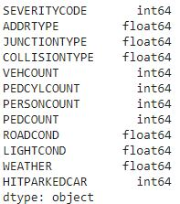
3.3 Feature Creation
Now the feature set is prepared for the machine learning model to work on. Here the Feature set has 12 attributes

Slide 8
3.4 Machine Learning Modeling
The data is split into Train (80 %) and Test (20%) for evaluation purposes. The data is then run on K Nearest Neighbour and Decision Tree Machine Learning Models.
X_train,X_test,y_train,y_test=train_test_split(X,y,test_size=0.2,random_state=4)

Slide 9
4. Result
The data is applied with K Nearest Neighbour and Decision Tree Machine Learning Models. The Jaccard Score anf F1-score was calculated to determine the accuracy of each model. For this project both the models used delivered similar results
Machine Learning Algorithm | Jaccard Score | F1-Score
K Nearest Neighbour | 0.74 | 0.71
Decision Tree | 0.74 | 0.71

Slide 10
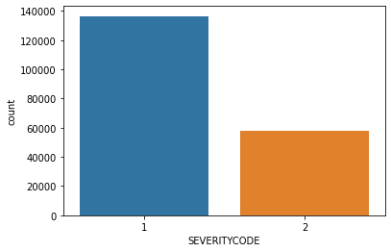
5. Discussion
In this project the accident severity were analysed and a model to predict the severity of the accident was created.
It is evident from the data that more accidents caused damage to the property than injury.

Slide 11
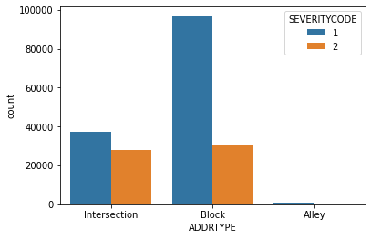
5. Discussion (Cont.)
After analysing the data, it’s understood that accidents happen more at Block Addresses than intersections or alleys. So it is advised to be more attentive at the addresses.

Slide 12
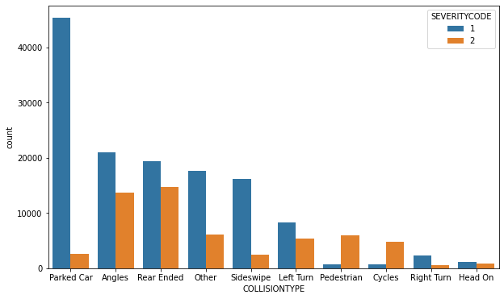
5. Discussion (Cont.)
The most common type of collision was parked car collisions for property damage collisions, but collisions at an angle caused the most number of injuries.

Slide 13
Conclusion
This project shows the advantages of using graphs and machine learning models to prevent or reduce road accident severity.
A driver may look at these analytics to identify areas of possible accident causes and be prepared for such occurrences.
The machine learning model may be used to predict the future outcomes and help the city management to create a plan to reduce the severity of such accidents.
With more and more data's being available, machine learning model’s accuracy will be improved and a safer traffic is assured.

